Slide 1


Enhancing Scale and Readiness for IPO in Social Buzz's Big Data Landscape

Slide 2


Today's agenda
Project recap
Problem
The Analytics team
Process
Insights
Summary

Slide 3

Review of key findings from the big data audit
Discussion of IPO readiness recommendations
Presentation of insights from the content category analysis
Clarification on the suggested technology enhancements
Agreement on the next steps for a successful long-term partnership
Project Recap

Slide 4

Identified strengths and weaknesses in Social Buzz's current big data practices
Recommended strategies for scaling their infrastructure
Proposed steps for ensuring a smooth IPO process
Highlighted opportunities for optimization and efficiency in content category management
Provided a roadmap for continued collaboration and improvement
Problem

Slide 5



=The Analytics team
1.Managing Director : Mae Mulligan
2.Industry Lead : Susan Curtis
3.Lead IPO Strategist : Florian Henry
4.Chief Technology Architect: Andrew
5.Seniour Industry Analyst -: Tim Pike
6. Investment Analyst: Steven Shaw
7. Senior Principal: Marcus Rompton
8. Industry Associate: Julia Hendric
9.Data Analyst : Bijili Parasa
10.Data Scientist: Michelle Grove

Slide 6
Process
1 Understand the project requirements and objectives.
2 Big Data Best Practices Presentation & data Audit
3 Sample Data Set Extraction and Content Analysis
4 Technology Architecture Workshop
5 Recap and Presentation

Slide 7

1. Optimal content category identification 2. Data infrastructure and enhancement opportunities 3.strengthening ipo readiness
Insights

Slide 8
Data Audit Insights
Big Data Audit:
On-site data center audit.
Identified strengths and areas for improvement.
Content Category Analysis
Content Categories:
Top 5 categories with the largest aggregate popularity.
Visualizations to showcase trends.

Slide 9
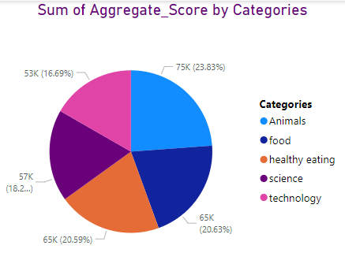
Visualization of Top 5 category Analysis

Slide 10

Summary

Slide 11
Thank you!
ANY QUESTIONS?

